Slide 1
Enhancing Inventory Optimization with Data Driven Insight
A business case for walmart
ERUMISELI DANIEL ALIU
BUS 6800 milestone 2 assignment
JANUARY 2025

Slide 2
Introduction: Unlocking Insights Through Analytics
Objective:
Optimizing inventory management and decision-making process through data analytics insights
Scope:
Exploration of Sales trend, Key influencing factors, Analysis of weekly sales, Predictive modelling of result and evaluation of model performance

Slide 3
Business Problem: Challenges in Inventory Management
Inventory overstock and understock leading to :
Loss of revenue
Increased holding cost
Customer dissatisfaction
Need for accurate demand forecasting to align inventory levels with sales patterns.

Slide 4
Data Driven Inventory Optimization
Predict weekly sales using machine models:
Linear Regression
Random Forest Regressor
Explore historical sales data and incorporate key influencing features.
Evaluate Model performance

Slide 5
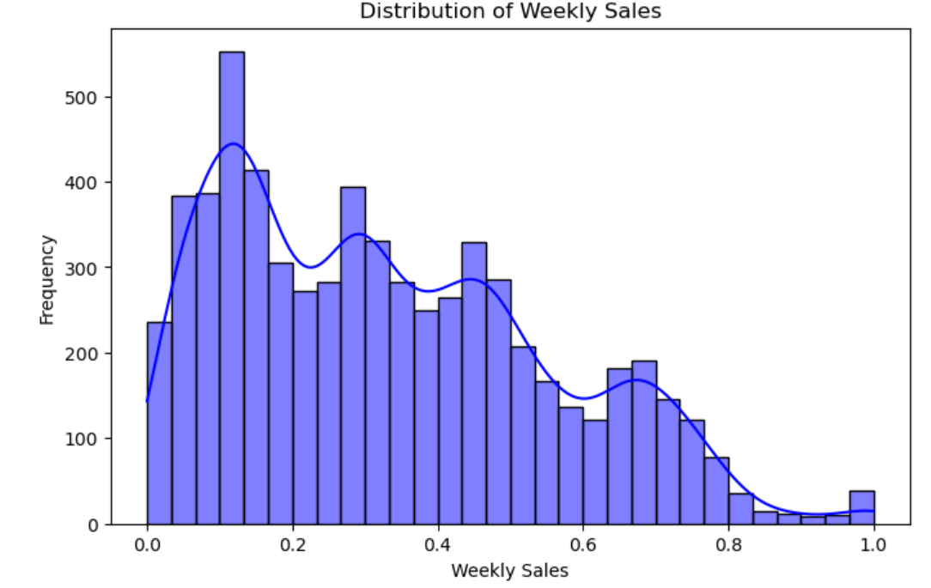
Exploratory Data Analysis
Key Features in the Dataset:
Store Type, Weekly Temperature, Fuel Prices, CPI, and Holiday Indicators.
Findings:
Distribution is right skewed
Weekly Sales (target variable) vary significantly across store types.
Potential need for transformation- better inventory allocation or targeted promotion

Slide 6
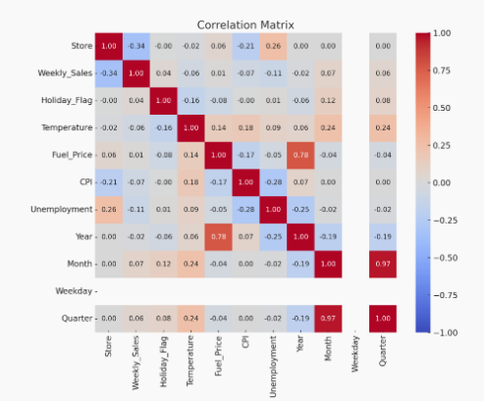
Exploratory Data Analysis
Insights from correlation matrix:
Month and Quarter is positively correlated with weekly sales
Store and unemployment as the strongest negative correlation with weekly sales
Store, Temperature and CPI show influence on Target variable but are not strongly correlated

Slide 7
Predictive Modelling Workflow
Data Preprocessing: Removal of duplicates and irrelevant columns.
Feature Selection: Focused on numeric features for prediction.
Model Training: Split data into training (80%) and testing (20%) subsets and train of the training set

Slide 8
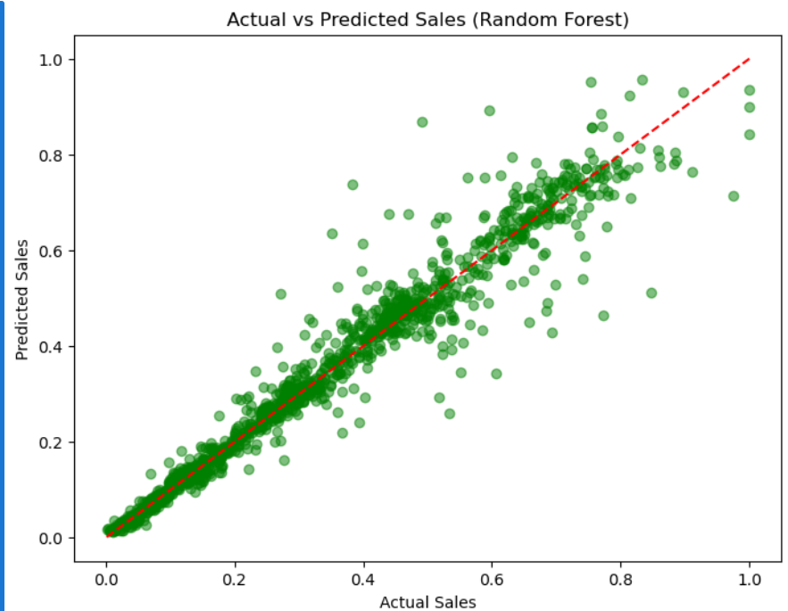

Performance Metrics
Linear Regression:
RMSE: 0.2047
MAE: 0.1719
R^2: 0.1549
Random Forest Regressor:
RMSE: 0.0498
MAE: 0.0276
R^2: 0.9500

Slide 9
Benefits of Model Implementation
Accurate demand forecasting reduces:
Inventory holding costs
Stockouts and overstock situations
Enhanced customer satisfaction through better product availability.

Slide 10
Actionable Steps
Implement the Random Forest model for real-time sales forecasting.
Integrate predictive insights into the inventory management system.
Continuously monitor and refine the model for evolving trends.
Train staff to utilize analytics tools for informed decision-making.

Slide 11
Tailored Insight for Stakeholders
Executive Leadership: Strategic decision-making using high-level trends.
Store Managers: Operational adjustments for stocking and promotions.
Supply Chain: Aligning logistics with predicted inventory needs.
Inventory Analyst: Reliable predictions for weekly demand planning.
IT Department: Highly accurate model, ready for seamless integration and scalable with infrastructure upgrades for faster computation
Project Team: Improved sales predictions enable strategic decisions in promotions, inventory stocking, and resource allocation.

Slide 12
Driving Growth with Analytics
Improved inventory alignment with customer demand.
Cost savings and increased efficiency.
Enhanced decision-making through data transparency.

Slide 13
Moving Forward
Next Steps:
Deployment of the model
Stakeholder training sessions
Continuous improvement cycle
Questions?

Slide 14
Thank you for your attention

